Slide 1


Power Automate and power bi doing what they do best
Laura GB

Slide 2


This is me
@Laura_GB
HatFullOfData.blog
HatFullOfData
Power Platform Consultant

Slide 3
What do they do best?
Power BI
Power Automate
Transform data
Calculations
Visualisation
Repetitive Tasks
Actions
Reacting / Responding
Analyse
Act

Slide 4



Problem definition

Slide 5
process

Slide 6
process

Slide 7
process

Slide 8
No more slides! It’s demo time!

Slide 10
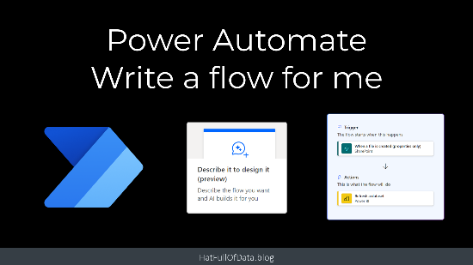
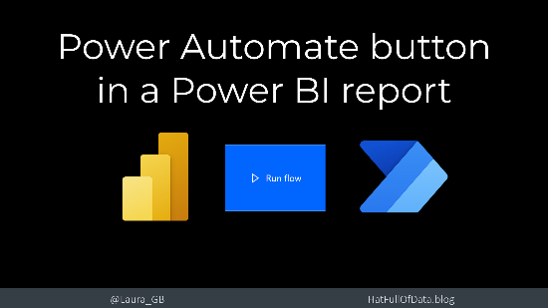
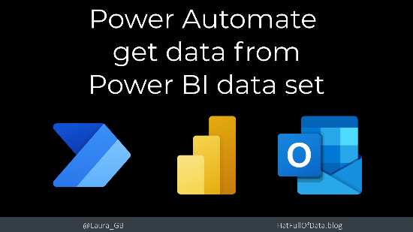

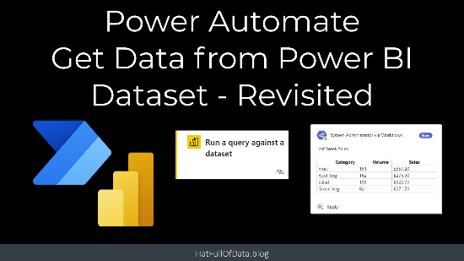
Resources
YouTube
Blog Post
YouTube
Blog Post
YouTube
Blog Post
YouTube
GitHub Resources
To build the demos

Slide 11
Thank you – Any questions?
@Laura_GB
HatFullOfData.blog
HatFullOfData
Power Platform Consultant

